Slide 1
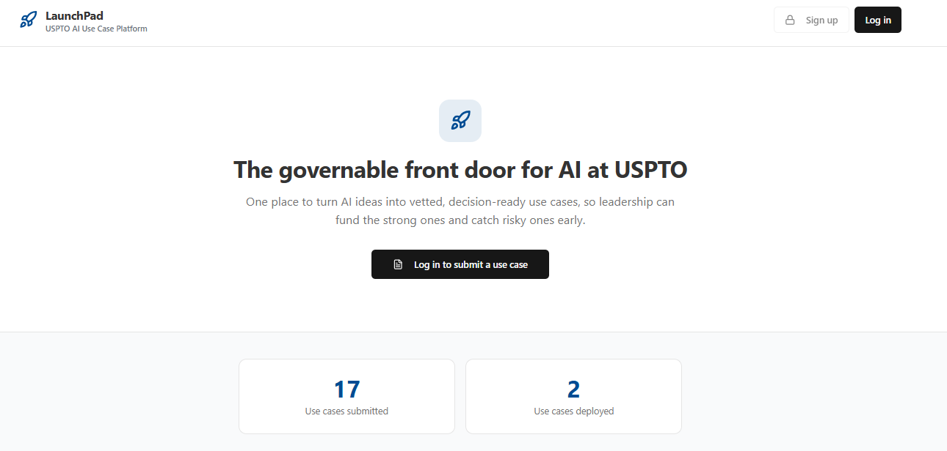
LaunchPad
The single source for AI ideation and use-case management.
LaunchPad runs the entire AI idea lifecycle in one place for everyone involved, not just the people who fund it. A submitter starts with the problem and turns it into a decision-ready use case, with a language model asking sharper questions as they go. Reviewers can see the entire pipeline and provide feedback in a tracked conversation. Leaders compare use cases side by side and decide what to fund.
Key Capabilities:
Guided AI-assisted intake that turns rough ideas into decision-ready use cases
AI coach that pressure-tests each idea and scores its readiness
Configurable fields with built-in responsible-AI risk questions
Reviewer pipeline with a request-info, edit-and-resubmit feedback loop
Decision Center to compare candidates and decide what to fund
Live status dashboard, plus PDF and work-tool exports
© 2026 Packaged Agile, LLC. Proprietary and Confidential.

Slide 2



AI Assistant and Architecture
AI-powered vetting turns rough ideas into qualified, decision-ready use cases
How it Works
Architecture
How It Works
At each step, the AI assistant pushes back on the submitter's answers, pointing out gaps and questioning weak assumptions. Once the answers hold up, one click turns them into a clean, submission-ready summary.
At each step, the AI assistant pushes back on the submitter's answers, pointing out gaps and questioning weak assumptions. Once the answers hold up, one click turns them into a clean, submission-ready summary.
Next.js 14 + TypeScript
App Router, React Context
Mission & Compliance Awareness
Tailwind CSS + shadcn/ui
Vets ideas against federal constraints, FedRAMP, 508, and your agency's realities
Custom-branded components
AI Integration Layer
Structured Output
Structured, validated responses from approved LLM
Schema-validated responses keep summaries consistent and well-formatted
LLM Engine
Inputs Preserved
Model agnostic. Adaptable to an approved endpoint
Raw inputs preserved alongside AI-polished summaries
Flexible Deployment
Containerized for on-prem, Cloud.gov, or GovCloud
© 2026 Packaged Agile, LLC. Proprietary and Confidential.

Slide 3
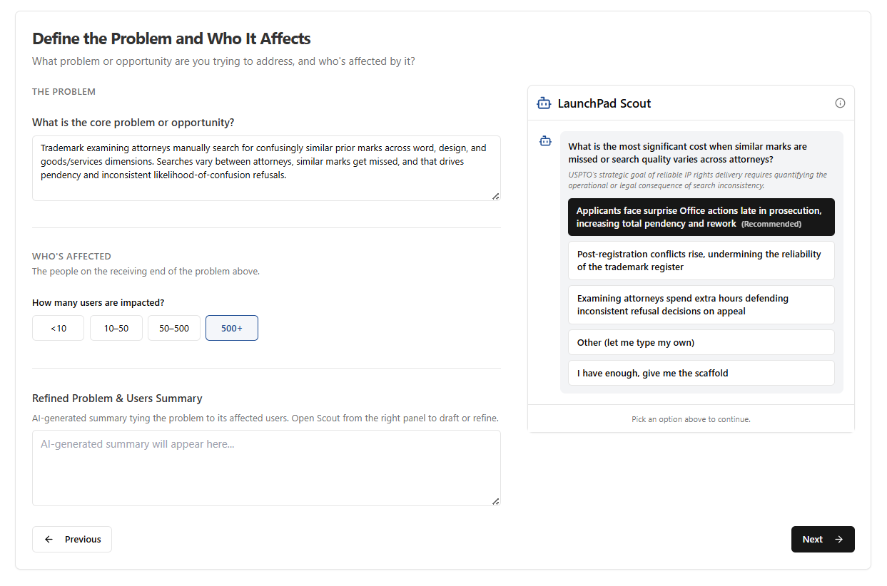
Guided Submission Workflow
A guided, plain-language workflow that turns raw AI ideas into decision-ready use cases
From Rough Idea to Business Case
LaunchPad walks every submitter through the idea one step at a time, forcing clarity on the problem, the users, the solution, its value, alignment, feasibility, and how success gets measured. The fields aren't fixed: admins turn nearly 50 of them on or off, so the form can run lean as a quick intake or deep as a full business case, depending on what your governance needs.
1
Submitter info (auto-filled)
2
Problem & target users
3
Solution, user, & business value
4
Governance, alignment, feasibility, & responsible AI
5
AI-drafted overview, readiness check, & submission
© 2026 Packaged Agile, LLC. Proprietary and Confidential.

Slide 4
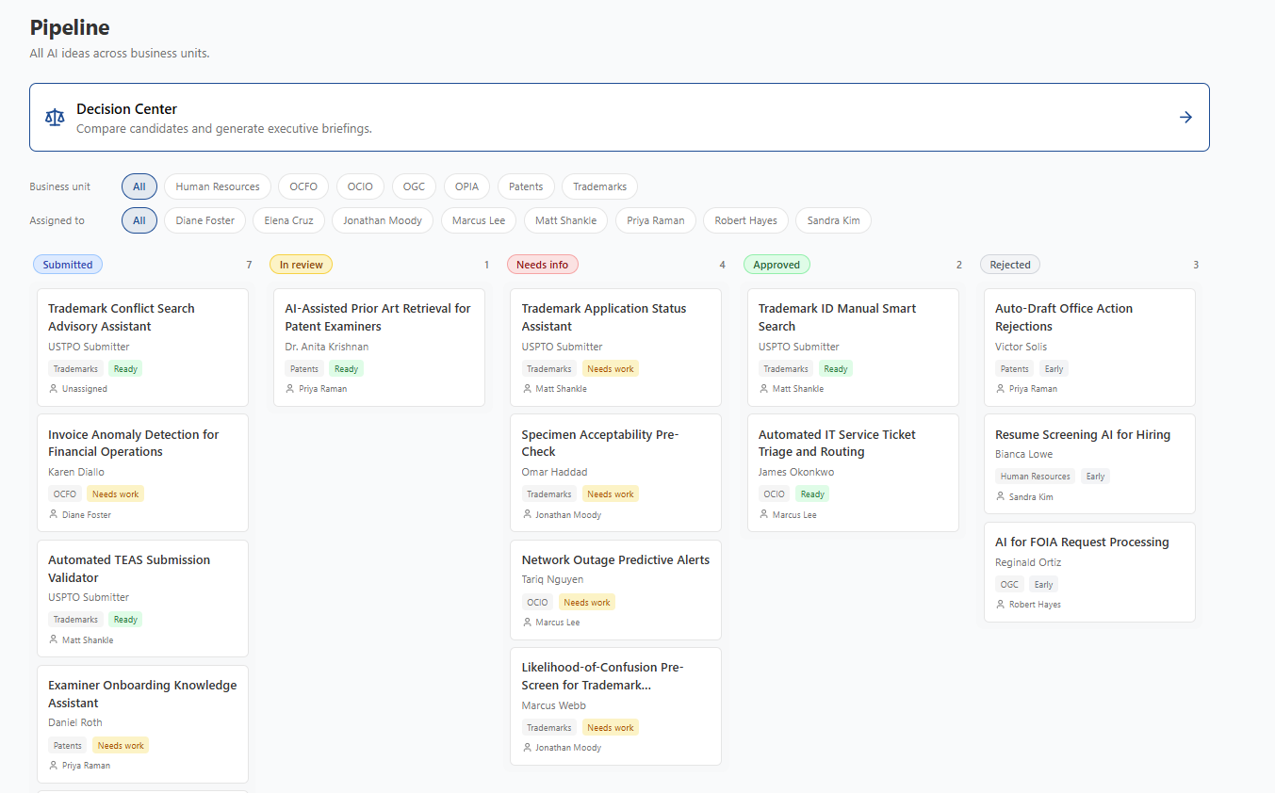
Pipeline Dashboard
Real-time visibility into the idea pipeline, from draft through approval
The Whole Portfolio in
One View
Reviewers and leaders see the whole portfolio in one place. Every idea moves through clear stages, from submitted to in review, needs info, approved, or rejected, and each one routes to the reviewer for its business unit. Filters narrow the board by unit or assignee, and a color-coded readiness mark shows which ideas are ready for a decision.
© 2026 Packaged Agile, LLC. Proprietary and Confidential.

Slide 5
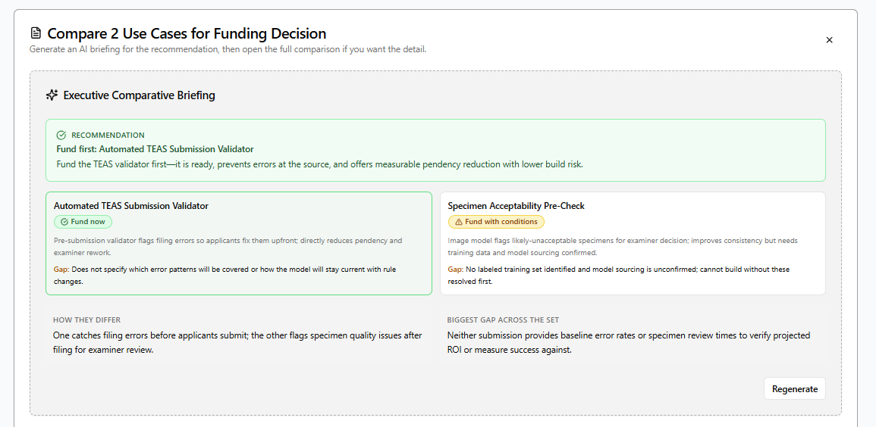
Decision Center
Compare use case submissions side by side and decide what to fund
How it Works
Select 2-4 candidates from the pipeline
Compare side-by-side, across every dimension
Get a recommendation with a verdict and a gap for each
Leadership gets a clear funding recommendation, with the full comparison behind it.
© 2026 Packaged Agile, LLC. Proprietary and Confidential.

Slide 6
Designed for Federal AI Governance
How LaunchPad is built to support the mandates agencies answer for
Federal requirement | How LaunchPad is designed to help
Annual public AI use-case inventory Advancing American AI Act | OMB M-25-21 | Acts as a live inventory for AI use cases. A single front door captures use cases as they arise and keeps them inventory-ready.
Minimum risk practices for high-impact AI OMB M-25-21 | Captures impact level and risk at intake. High-impact cases are flagged for added review before they can advance.
CAIO oversight and documented decisions OMB M-25-21 | Gives reviewers one board to record fund, conditions, or hold decisions with the reasoning attached.
AI Risk Management Framework NIST AI RMF 1.0 | Govern and Map | Structures intake around the Govern and Map functions and builds a documented decision trail. Measure and Manage, the ongoing monitoring, sit in other systems.
Security authorization and accessibility NIST SP 800-53 | Section 508 | Designed to produce the risk documentation that supports an ATO. Section 508 accessibility is a design goal, not yet independently tested.
LaunchPad is a working prototype. These points describe how it is designed to support each requirement. They are not certifications and have not been independently validated or authorized in production.
© 2026 Packaged Agile, LLC. Proprietary and Confidential.

Slide 7
FOR MORE INFORMATION, CONTACT
Matt Shankle
Director
703-431-2878
matt.shankle@packagedagile.com
Results Delivered
www.packagedagile.com

